Slide 1

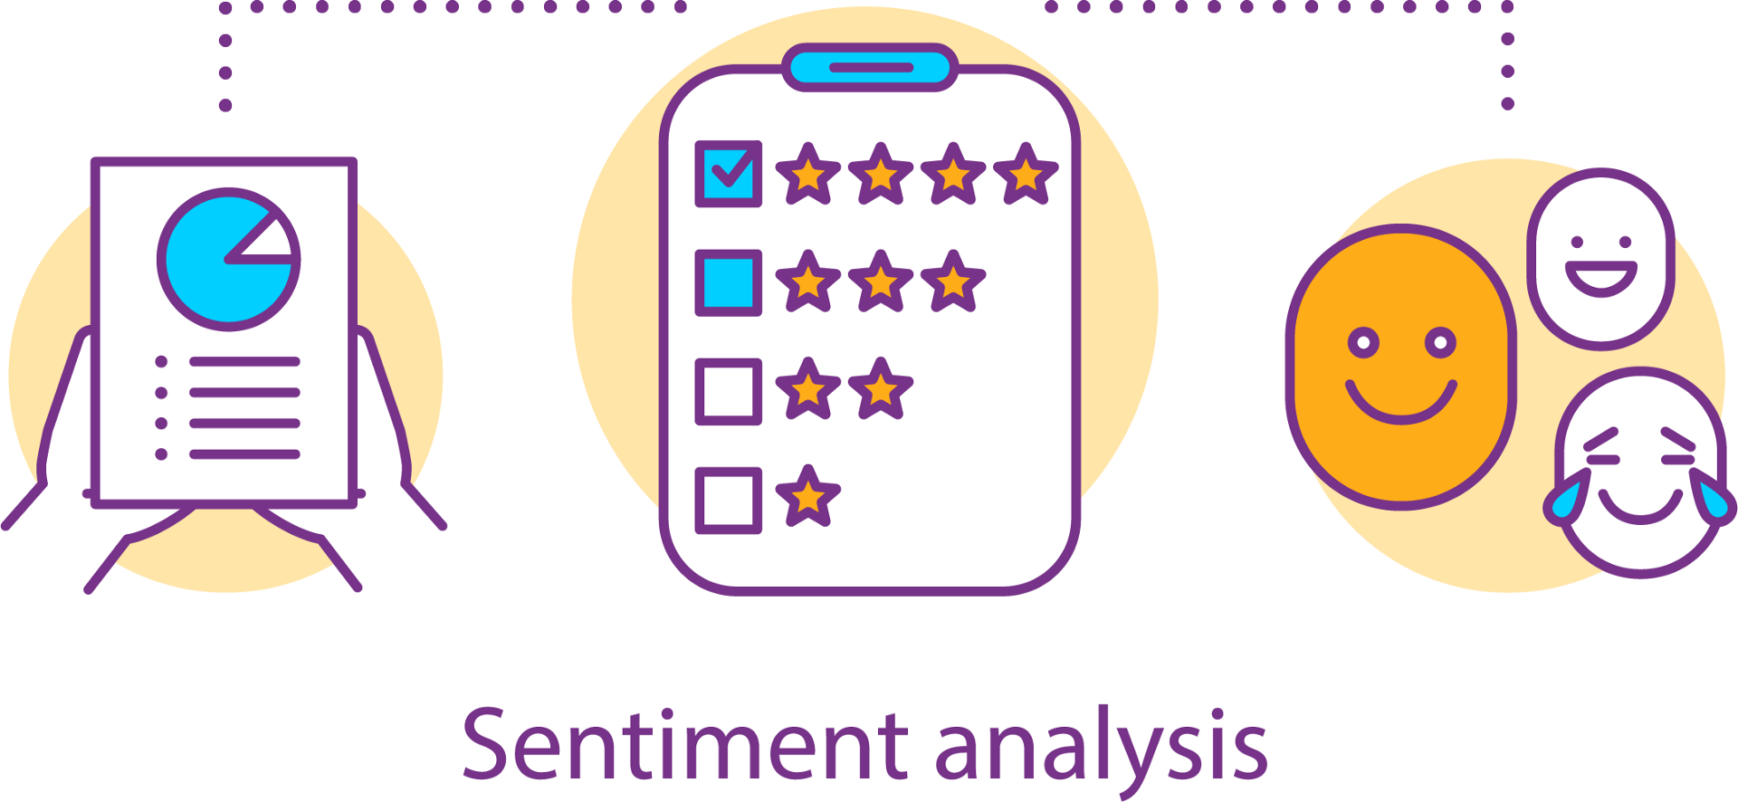
Sentiment Analysis
on
Amazon Instruments Reviews Dataset
Efforts by:
Tanvi Tiwari (181468)
Vardhan Chambial (181425)
Under the guidance of :
Dr. Rajni Mohana- Associate Professor (CSE Deptt.)
Group No. 69

Slide 2
Introduction
______________________________________
Our Project is based on one of the Applications of
Sentiment Analysis -- Customer Feedback
Customer feedback plays an important role in making business decisions. Allowing firms to respond to the needs of their customers and thus reduce customer stress and keep them competitive.
Customer feedback helps an organization better understand their customer feedback so that they can focus on customer problems.
Our project emphasizes a lot to consumers and helps them have a better view of any Musical Instrument they are interested in by looking positively at reviews provided by people.
The project provides the entry and exit of customer feedback analysis so that we can turn the response into customer feedback.

Slide 3
Project Objective
Project Motivation
The purpose of this project is to analyze the Musical Instrument Review database that we have taken from Kaggle and perform Sentiment Analysis on it to determine if people like the product or not.
Every day we come across a variety of products and it’s difficult for a customer to choose something and to understand customer feedbacks through ratings since they are easily sorted and judged on whether the product is good or bad. Motive doubled for consumers and manufacturers highly value the "customer ideas" about products and services.

Slide 4
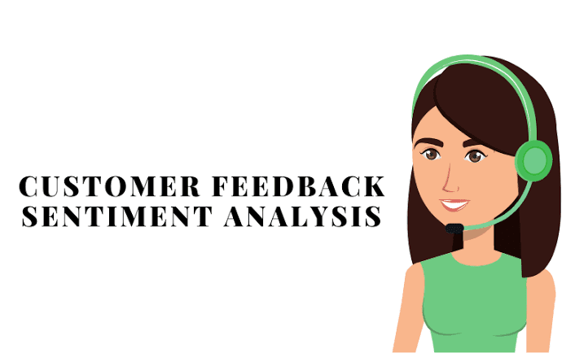
Problem Statement
To classify individual comments/ updates and determine the overall rating based on individual comments / updates. So that company can get a complete view of the feedback given to customers and can take care of those specific areas.
Build the model which has highest accuracy in classifying the feedback as Positive, Negative.

Slide 5
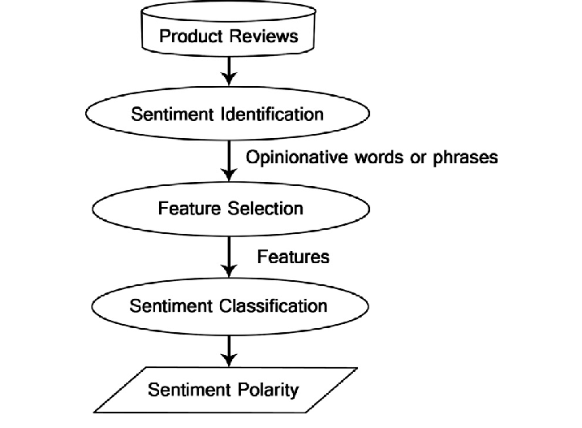
Approach Data Flow Diagram
We are taking our dataset from Kaggle.
Performing pre-processing techniques
Using SentiWordnet of NLTK module to label our pre-processed data as positive or negative
Using various machine learning models to check how accurate our model works
Analyzing Amazon instruments training dataset using sentiment analysis model.
Visualize the results of sentiment analysis done on our dataset.

Slide 6
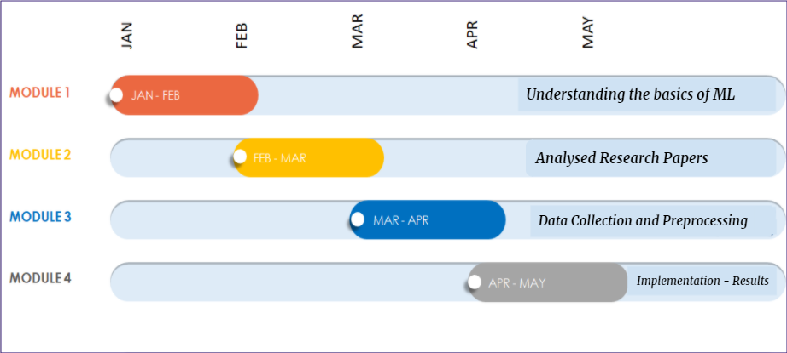
Timeline of the Project

Slide 7
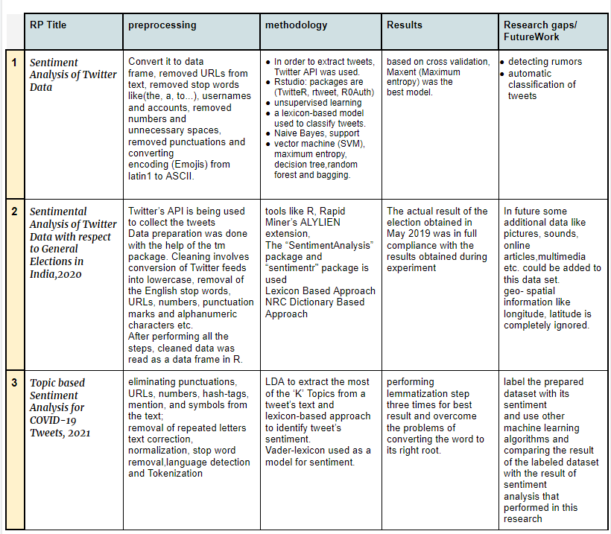


Slide 8
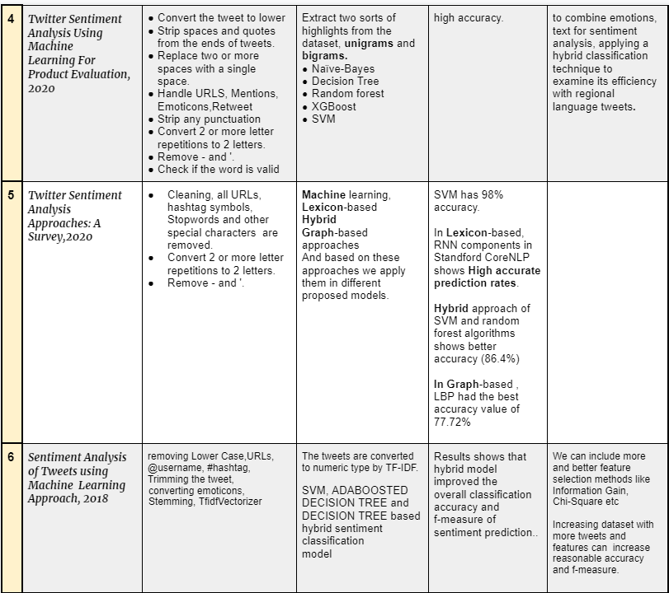

Slide 9
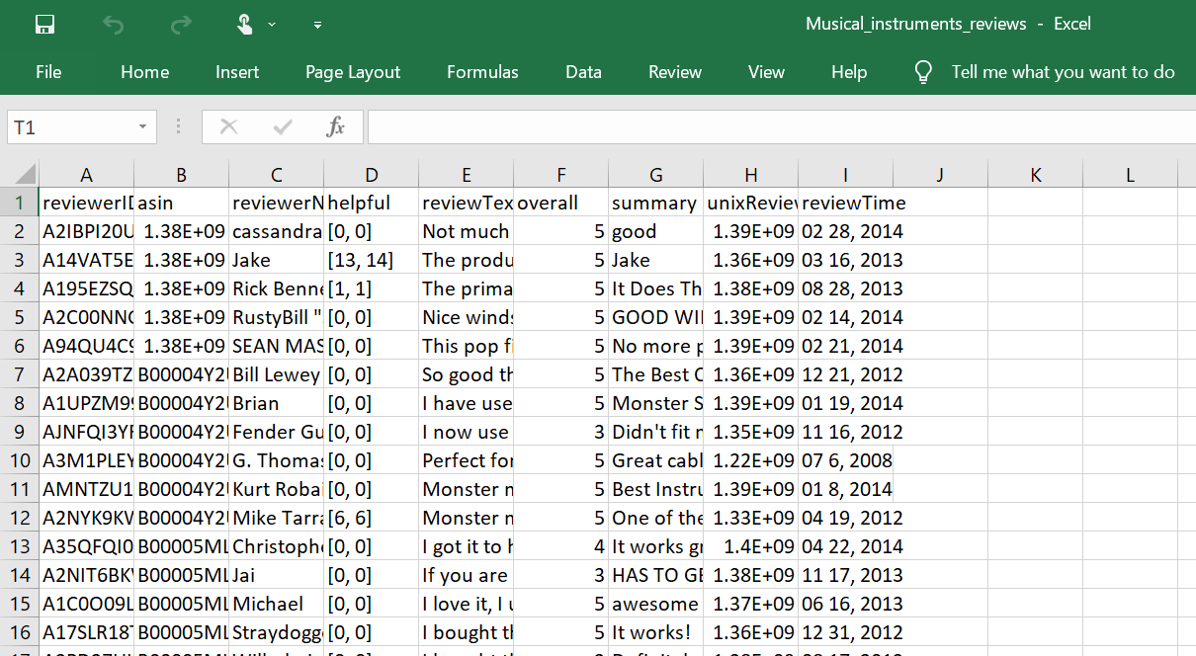
Dataset Used
We have taken our dataset from Kaggle, named “Amazon Musical Instruments Reviews” in CSV format
The Amazon reviews full score dataset is constructed by randomly taking 10,000 samples out of 1,00,000
Fields:
Reviewer ID, User ID, Reviewer Name, Reviewer text, assistant, Review period, Rating on the scale 5, Summary (found in Reviewer text).

Slide 10
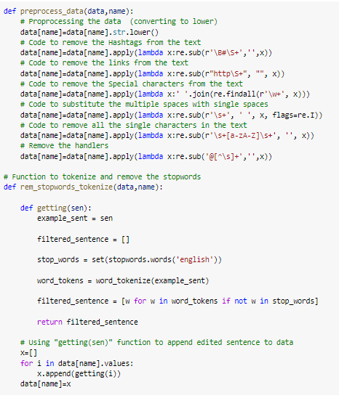
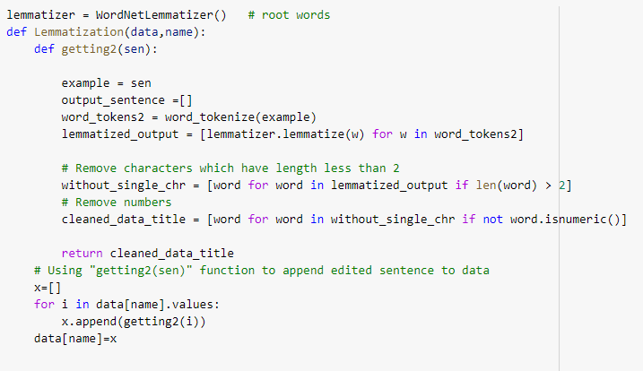
Data Preprocessing
Cleaning Data by converting data to lowercase and removing special characters and links and hashtags,etc.
Using WordNetLemmatizer for converting a word to its base form
Notes:
Tokenization: separating a piece of text into smaller units called tokens. Here, tokens can be either words, characters, or subwords
Filtering: that will remove words such as: stop words, extremely repeated words and rarely repeated words,
Stopwords are the most common words in any natural language. For the purpose of analyzing text data and building NLP models, these stopwords might not add much value to the meaning of the document. Generally, the most common words used in a text are “the”, “is”, “in”, “for”, “where”, “when”, “to”, “at” etc.
Stemming and Lemmatization both generate the root form of the inflected words. The difference is that stem might not be an actual word whereas, lemma is an actual language word.
Lemmatization: which will be used to transform all the verbs to the infinite tense and all the nouns to the singular form.
Stemming: will be used to return all the words to their basic forms where it will remove the plural ‘s’ from the nouns and the ‘ing’ from the verbs.

Slide 11
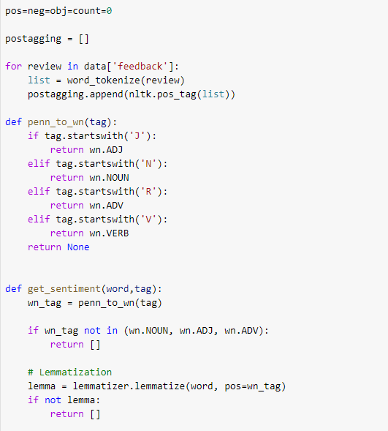
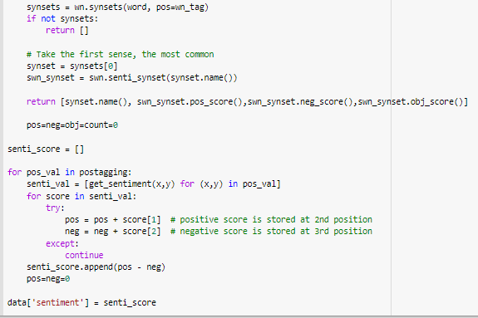
Using part-of-speech tagging for marking up a word in a text as corresponding to a particular part of speech, based on both its definition and its context.
Using SentiWordNet to assign to each synset of WordNet three sentiment scores: positivity, negativity, objectivity.

Slide 12
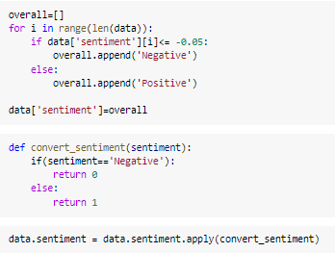
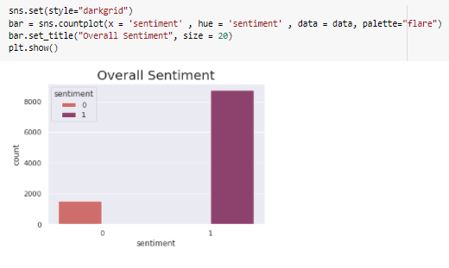
Plotting the Overall Sentiments
Converting Sentiments to Positive(1) and Negative(0) based on their total sentiment score.
The plot tells us that our data is imbalanced

Slide 13
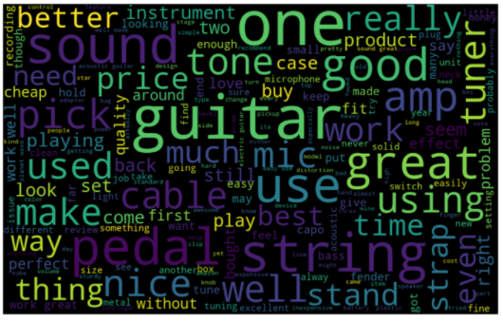
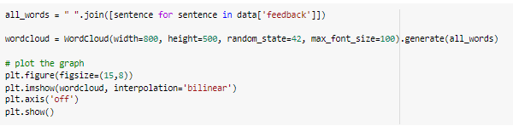
Generating a Word Cloud
(Highlights popular words and phrases based on frequency and relevance.)

Slide 14
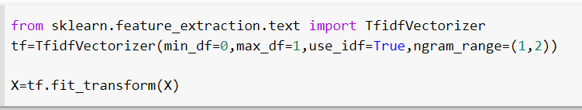
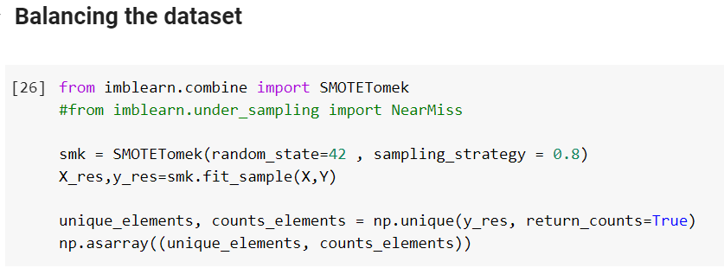
Creating Feature Vectors and Balancing the Dataset
Convert a collection of raw documents to a matrix of TF-IDF features using sklearn.feature_extraction.text.TfidfVectorizer
Over-sampling using SMOTE and cleaning using Tomek links.

Slide 15
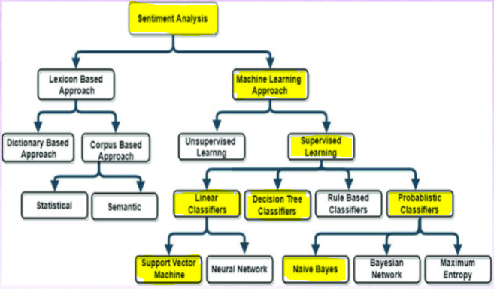
Sentiment Classification Approaches

Slide 16
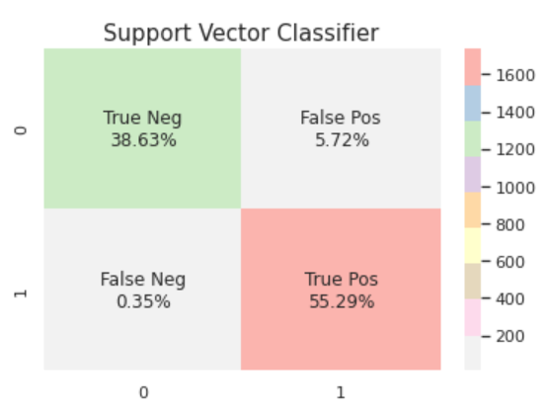
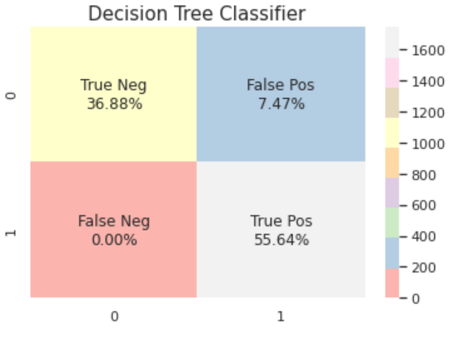
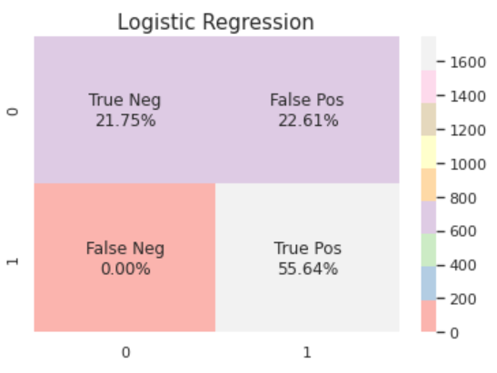
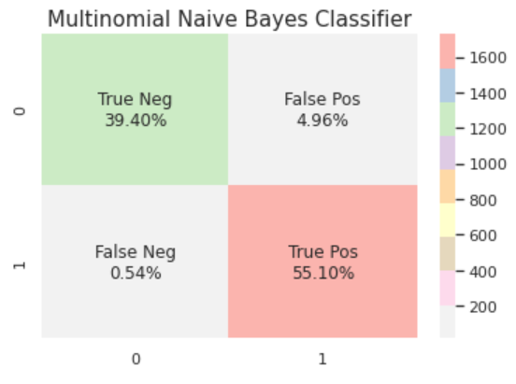
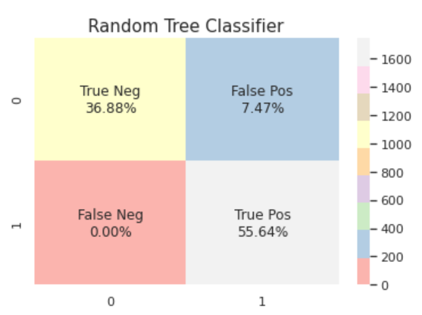
Discussion on the Results Achieved
After testing some arbitrary reviews, it seems that our features is performing correctly with Positive and Negative results.
We also see that after running the search, our MultinomialNB Classifier has improved to 94.50% accuracy level.

Slide 17
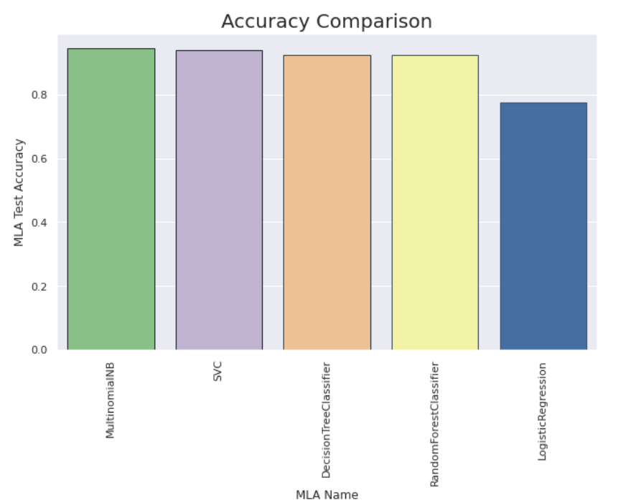
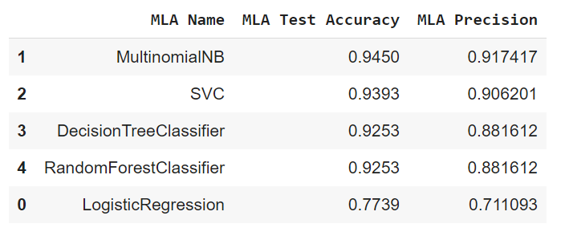
After testing some arbitrary reviews, it seems that our features is performing correctly with Positive, Negative results.
We also see that after running the search, our MultinomialNB Classifier has improved to 94.50% accuracy level
Discussion on the Results Achieved

Slide 18
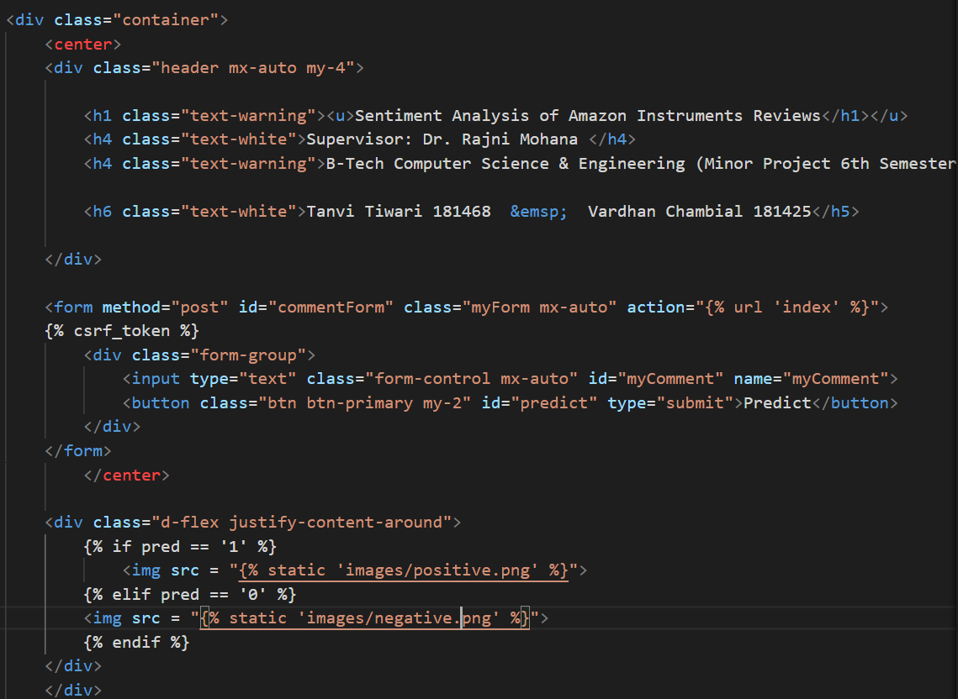
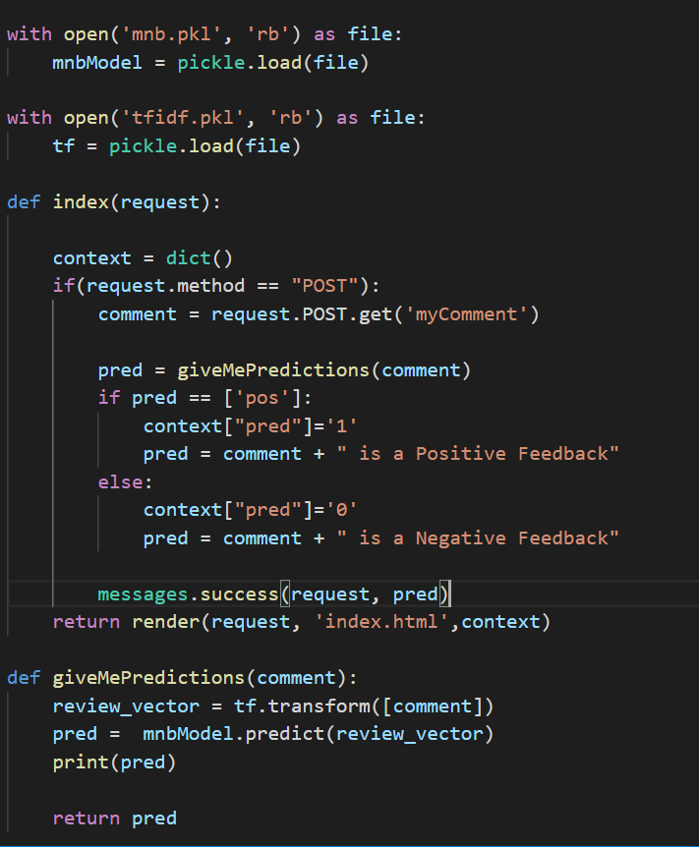
Deploying the Model

Slide 19
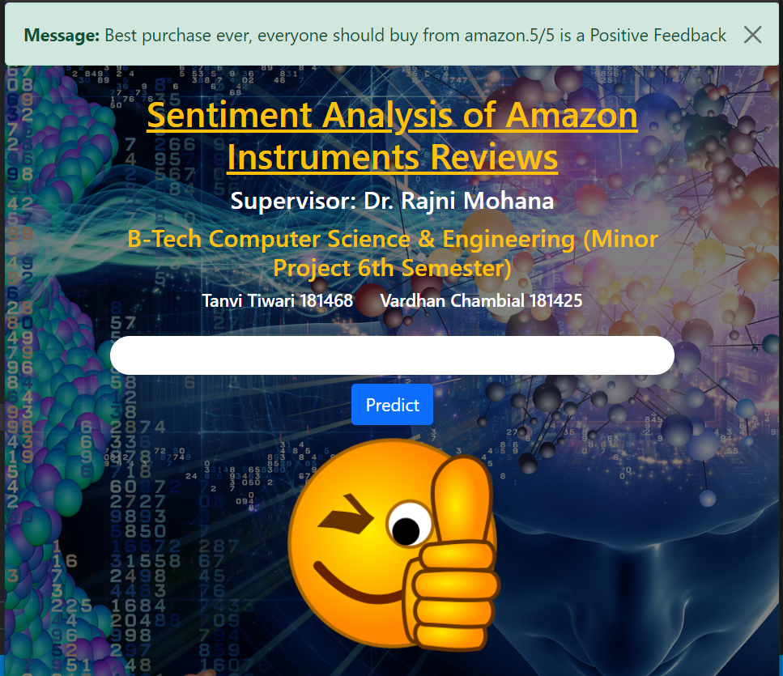
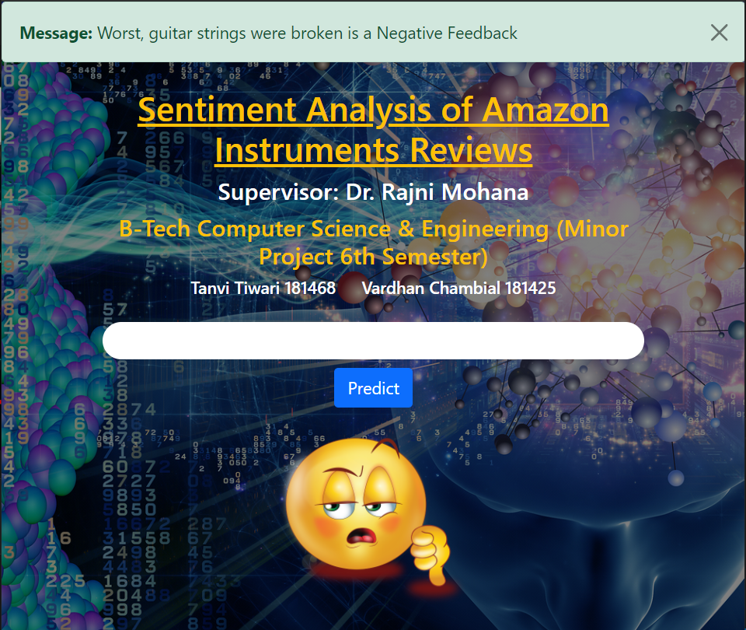
Predictions
For a Positive Feedback, The model returns with ‘Positive’ and vice-versa.

Slide 20
Applications Of Our Project
Our Project Itself is based on one of the Applications of Sentiment Analysis -- Customer Feedback
This project provides the entry and exit of customer feedback analysis so that we can turn the response into customer feedback.
Many companies manually analyze customer feedback details, but at a high volume level, there are many human-enabled analytics problem.
Text analytics eliminates the need for human-enabled analysis. Emotional analysis, a subset of text analytics, classifies this text as positive, negative, or neutral and can do up to 100,000 reviews per minute. While NLP can convert unedited text into unmeasured data.

Slide 21
Future Work/Scope
Our work is currently limited to just english language data exclusively, and we focus to expand our work to many other languages,
Another work that we wish to do in future is to detect sarcasm where someone might rate the product more and give bad reviews or vice versa in order to achieve better results for custom feedback.

Slide 22
References
References
Sarah E. Shukri, Hamad Alsawalqah, Ibrahim Aljarah, Rawan I. Yaghi , 2015 IEEE Jordan Conference on Applied Electrical Engineering and Computing Technologies (AEECT) on a paper on Twitter Sentiment Analysis: A Case Study in the Automotive Industry.
Vishal A. Kharde, S.S. Sonawane, International Journal of Computer Applications (0975 – 8887) on a paper on Sentiment Analysis of Twitter Data: A Survey of Techniques.
Aliza Sarlan , Chayanit Nadam , Shuib Basri , 2014 International Conference on Information Technology and Multimedia (ICIMU) , Twitter Sentiment Analysis : Social Media.
Bhumika Gupta, Monika Negi, Kanika Vishwakarma, Goldi Rawat, Priyanka Badhani , 2017 International Journal of Computer Applications (0975 – 8887), Study of Twitter Sentiment Analysis using Machine Learning Algorithms on Python.
A. Brahmananda Reddy, D.N.Vasundhara, P. Subhash, 2019 International Journal of Recent Technology and Engineering (IJRTE) Sentiment Research on Twitter Data.

